Slide 1
Homeland Security Healthcare CBRNE Readiness Center for Health Care Emergency Readiness
Myths and Realities
In Healthcare Emergency Readiness
November 2012

Slide 2
Homeland Security Healthcare CBRNE Readiness Center for Health Care Emergency Readiness Hospital Division

Slide 3
Words of Wisdom
“The history of man is a graveyard of great cultures that came to catastrophic ends because of their incapacity for planning, rational voluntary reaction to challenges”
Erich Fromm
The public health and healthcare sector: “weakest link” in the homeland security chain

Slide 4
Background and Context
Personal outrage at 911 target sites, mostly the Pentagon, where the plane literally hit my old office
Self Funded Nine-Month Study to answer the question:
Is the Nation’s Non-Federal Healthcare Industry meeting its expected Role in Homeland Security CBRNE Readiness?
Answer-NO
Why?
Complex set of reasons-Among them are Urban-Suburban-Exurban-Rural MYTHS which are the subject of this presentation

Slide 5
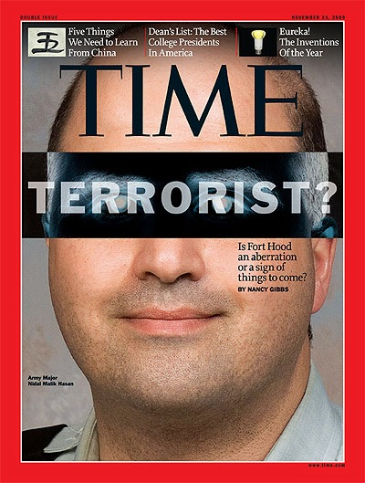
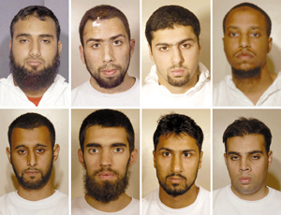
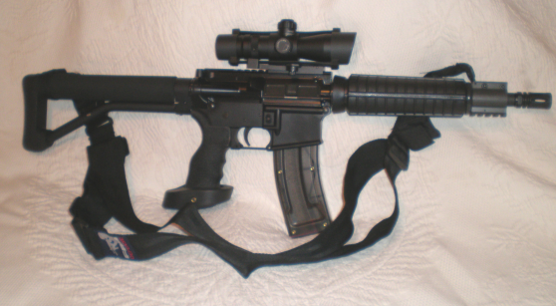
Four Areas Dominate Safety and Security Threats
Evolving Infectious Diseases-SARS-Avian Flu etc.
More Robust Natural Disasters –Katrina-Floods, Sandy, etc.
Increasing evidence of future Terrorist Threats (Insider Threats, TME, TDT)
Stakeholder Workplace Violence – Internal and External

Slide 6
Common Myths and Realities Concerning Healthcare Community Threats Prologue to 2012 Update
October 2012
This is a “living” presentation and is updated periodically to reflect the changing nature of threats to Public Health and Healthcare Sector. This revision was completed in the third quarter of 2012.
We have been surprised and disappointed at the lack of in-depth healthcare media coverage of all hazards, particularly coverage of super-storm Sandy. The same mistakes that were made during preparation and response to TS Allison (2001) and Hurricane Katrina (2005) were lessons not learned by NYC in responding to Sandy – with a little more flooding it could have easily been of repeat of the 334 bodies recovered from Katrina hospitals and nursing homes.

Slide 7
Myth 1 – The Government is Ready to Help
Reality The National Response Plan, through the National Incident Management System, provides for limited assistance for the first seventy-two (72) (96) hours following a significant ALL HAZARDS event.
The timeliness of federal level assistance is a function of the nature of the incident, the national security estimates, and federal mission priorities. Multiple national incidents may delay federal assistance for unknown time frames. An organization's survival depends on its own vigilance and application of the Readiness elements of:
Mitigation
Preparation
Response
Recovery
Myth
The nation’s healthcare community is prepared to respond to an increasingly hostile environment.
Example:
Re-prioritization of assets away from Hugo to San Francisco Earthquake Event.

Slide 8
Coverage Gap in Outside Healthcare Response
Event
Pre-Incident Capability
Local Medical Response
Surge (local capability)
Federal Medical Support
3
5
4
2
Lessons Learned have shown that this “GAP” area is the most vulnerable for sustained operation.
96 Hours
1

Slide 9
Myth 2 – Rural Facilities are Not Targets
Reality Agro-Terrorism is a real threat; the first line of defense is small rural or critical care facilities. Their ability to detect and treat cannot be overstated. Rural areas have the highest probability of being the recipients of "crop duster" attacks, crop dusting being a familiar activity in those areas.
Myth According to our HVA experts, the probability of our area being a target is nil because “we are a small rural facility.”
Update:
Rural Hospitals are the first line of defense in recognizing Natural or Manmade Threats to Food Sources including animals.

Slide 10
Myth 3 – Suburban Facilities are Not Targets
Myth According to our HVA experts, the probability of our area being a target is nil because “we are a suburban facility; the large metropolitan facilities and local governmental planners are preparing for terrorist response; the probability of our direct involvement is unlikely.”
Reality Clustered urban healthcare facilities are seen as soft infrastructure targets with high probability as "dirty bomb" victims. Destruction of these healthcare assets forces care to the suburbs and beyond. This strategy, whether the medical centers are the primary target or an attack in tandem with a high profile urban target in the vicinity, is designed to maximize lethality and deny treatment for victims.
Terror Multiplier Effect.
Update:
Selection of Terrorist Targets are based on Opportunity.
Gun violence continues to escalate in all hospitals; Mumbai-like attacks are a real threat

Slide 11
Myth 4 – No Legal Obligation
Myth We have not formally participated in local or regional planning or received any federal grant funds for CBRNE readiness so we are not obligated to have an emergency management plan that meets NRP/NIMS/ICS expectations.
Reality Homeland Security Presidential Directives have designated all hospitals and clinics as Critical Infrastructure/Key Assets and medical staff as First Responders/First Receivers. DHHS's Center for Medicare and Medicaid Services (CMS) requires all-hazards (including CBRNE) preparedness as a Condition of Participation (COP).
Update:
NOLA Hospitals sued and settled for millions; medical staff arrested and charged with Murder of Patients.
New Case Law exposes hospitals to litigation for not being prepared for known threats.

Slide 12
Myth 5 – We are Low Profile; Low Risk
Myth Everyone knows that terrorists are looking for spectacular, high victim count, high profile targets. We don't meet any of those criteria so we have little to fear.
Reality Recent intelligence estimates indicate that the likelihood terrorists would choose one large target has reduced by twenty-five percent (25%) and selection of multiple smaller targets has increased. Target selection is partially a function of access; as larger targets "harden," selection of "softer" more vulnerable targets are more likely. Recent insurance industry target modeling also reflects a shift away from larger targets.
Update:
All hospitals with Medical-Use Radiological Materials (MURM) are subject to “explode on site or steal for later use” scenario.
NRC reports 5,000 MURM devices have been lost, misplaced or stolen.

Slide 13
Myth 6a – We are Low Profile; Low Risk
Myth Hospitals and clinics are unlikely terrorist targets, and if they were selected it would be large famous medical centers in urban settings. It is improbable that a small town healthcare facility would be targeted.
Reality Recent highly suspicious activities involving fake federal and accrediting hospital inspectors appearing in the middle of the night asking for building tours have little common pattern relative to size, geography, ownership or specialty.
A spate of unexplained intense interest in specific areas of healthcare facilities focused on pharmacy and radiology departments had little in common with facility characteristics.
Theft and questionable purchases of used ambulances appear to be geographically random events.
Update:
All hospitals with Medical-Use Radiological Materials (MURM) are subject to “explode on site or steal for later use” scenario.
Workplace and Gun Violence continues to grow in all hospitals.
Many Hospitals are not prepared for Earthquakes, etc.

Slide 14
Myth 6b – Are We at Stage 3 or 6?
Continued Reality The use of vehicles as future terrorist delivery systems is commonly accepted, with VIP limos and ambulances heading the list. One unsettling aspect associated with the imposter inspectors centers on the commonly accepted hierarchy of threat recognition indicators (TRI).
Many experts classify these TRI along a seven-stage continuum from "marking the target" to "attack." Stage three is characterized as "gathering information" and stage six as " rehearsal." The troubling question is, are these activities stage three? If so, it is early in a normally patient and protracted process. But if they are stage six, the next stage is "attack." The acquisition and short-term storage of ambulances would appear to be a late stage activity.
The Terrorist Recognition Indicators (TRI) has Seven Indicators
Threat Recognition Indicators (1-7)
Marking the Target
Surveillance
Gathering Information
Planning
Tooling Up
Rehearsal
The Attack
1
2
3
4
5
6
7

Slide 15
Myth 7 – All Hazards Training is Complete
Myth Hospital personnel, particularly professional staff, are all trained in recognition and treatment of All Hazards related casualties. Our doctors and nurses are already trained to treat mass casualties of all types. They are too busy to participate in All Hazards education and training exercises; when the time comes, they will know what to do.
Reality Post 9/11 CBRNE emergency management exercises and their after-action/lessons learned revealed that the lack of a All Hazards working knowledge base among health professionals (recognition and treatment of CBRNE casualties) was and is a significant weakness in the system. The need for health professional involvement in all-hazards planning and their active participation in realistic All Hazards exercises are essential to meet future threats.
Update:
Recent Events have surfaced the lack of All Hazards Education and Training among Professionals.
Failures in Katrina, IKE, Joplin and Derecho tornados stretching from Midwest to East Coast underscore a lack of Training and Execution.

Slide 16
Myth 8 – Full Staff Participation in Event
Myth Hospital personnel, at all levels, are willing to actively participate in a real All Hazards hostile environment. Our hospital personnel are willing to place themselves in harm’s way in the event of an actual All Hazards threat environment.
Reality Recent experience with the SARS threat brings into question the validity of this general statement. Incidents of refusal to work in such an environment were not unusual. One state survey revealed that half of physicians and nurses answered NO to a question about their willingness to participate in a real CBRNE event in a non-hospital setting. This signifies that in a high percentage of real CBRNE events the hospital is on lock-down. There is no substitute for strong leadership, effective training, and understanding in the use of protective equipment and confidence in personal survival in a CBRNE environment.
Update:
Failures in Katrina, Ike, Joplin and Derecho tornados stretching from Midwest to East Coast underscore the Reluctance of Full Staff Participation in Emergencies in general and Bio-Events in particular.

Slide 17
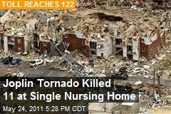
Myth 9 – System has Been Tested
Reality We have gained some insight from those experiences, however, they were largely mortuary management events. One significant lesson learned was that healthcare facilities were ill prepared to deal with huge crowds looking for friends and family members. An accompanying biological or chemical attack would have resulted in the immediate contamination of area healthcare resources.
Myth The healthcare system has been tested by the Oklahoma City bombing and the 9/11 attacks on New York and the Pentagon. We have sustained terrorist attacks and we understand a lot more about how to deal with them.

Slide 18
Myths and Realities – 10
Myth All Hazards responses are not that different from ones used to deal with natural hazards and the occasional hazmat events. We have been able to deal with multiple catastrophic events--most recently, four major, destructive hurricanes in one season.
Reality Expected new strategies from the terrorist community will test our creativity and resolve. New terror tactics include:
CBRNE attacks to coincide with predictable natural hazard events, hurricanes as they make landfall, peak flood levels, immediately following earthquakes or coinciding with aftershocks
Introduction of different biological agents at peak known endemic or pandemic events
Introduction of chemical agents to co-mingle with smoke from forest fires, etc.
Increased numbers in bio-labs handling Toxins and bio-agents, as well as the staff with access, has increased x-fold
Update:
The probable intentional setting of forest files carries three major consequences:
Direct Economic Loss of Resources
Threat to Lives
Diversion of All Hazards Resources

Slide 19
Myths and Realities – 11
Reality In the case of the hurricane you have the advantage of knowing hour by hour the location, velocity and direction of the hazard. There are essentially two elements to deal with, wind and water.
Conversely, when dealing with an unanticipated chemical agent attack, the decision window time is short, and there are multiple elements to consider:
agent identification and knowledge of it characteristics,
wind speed and direction,
concentration of agent,
structural integrity of building,
efficiency of exit routes, etc.
Myth Making the decision to "protect in place or evacuate" in a CBRNE terrorist event is about the same as preparing for a category three hurricane, which we do that every year.
Katrina/New Orleans could have been much worse under a terrorist event.

Slide 20
Myths and Realities – 11b
Reality Continued If the decision is made to "protect in place," depending on the agent, there are multiple variables to consider as well, such as:
Should we go to the top floor or to the basement?
Who receives the limited amount of protective equipment?
If the decision is made to "to evacuate," the considerations are no less complex.
You get the picture. It’s time to get real and gain real understanding of how to prepare our healthcare systems.

Slide 21
Healthcare Workplace Violence
Myth Hospitals are a safe environment for stakeholders.
Reality Hospitals are among the most dangerous places to work in the nation. Dangers come from many sources;
Diseases and Infections
Caregivers are 4X more likely to be assaulted than other industries
Assaults
Staff of Staff Violence
Staff on Patient Violence
Patient on Staff Violence
Stranger on Caregiver Violence
Murder
54 Caregivers have murdered 2100 + patients (2000-2004)

Slide 22
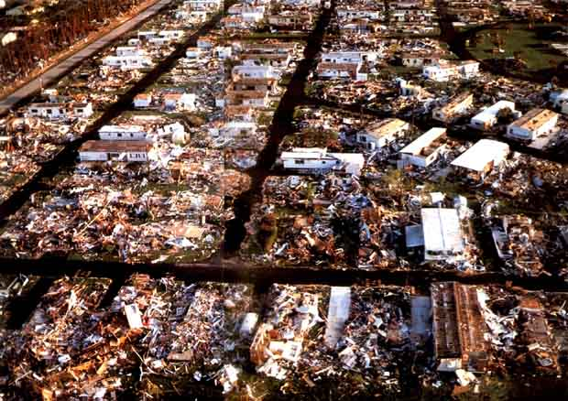
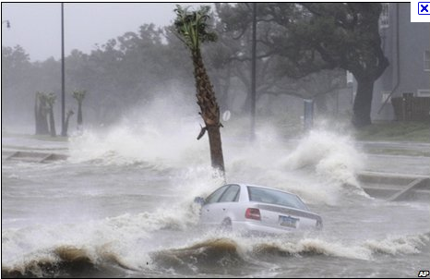
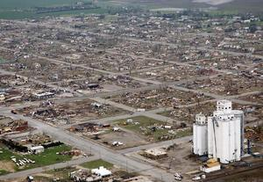
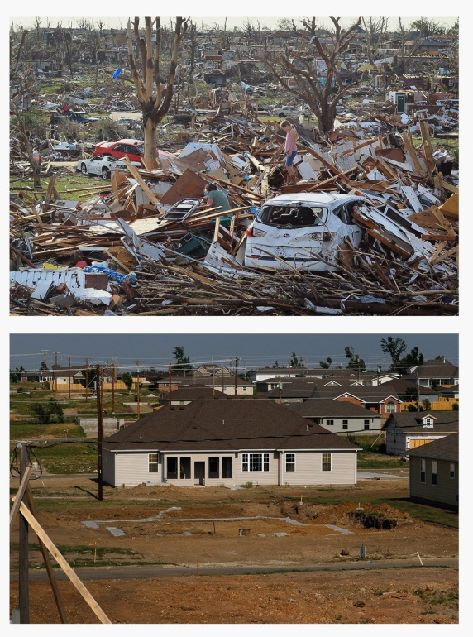
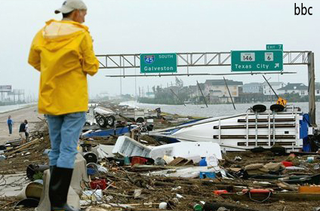
Lessons Learned from Recent Disasters
We have seen from recent disasters, especially Katrina, that the Healthcare infrastructure is not ready to satisfy its responsibilities to a trusting public, in general and the most vulnerable among us in particular.
Greensburg
Andrew
Ike
Joplin
Gustav

Slide 23
Special Items which may be Sensitive and Politically Incorrect

Slide 24
Physician Shortages
26% of the nation’s practicing physicians are International Medical Graduates (IMGs), many from the Middle East and Indian Sub-continent.
Experts say the existing supply of domestically produced physicians will not keep pace with the known growing populations.
Supply of domestically trained physicians is expected to drop precipitously as Healthcare Reform hits its’ peak.
Following the lead in the UK after physician homicide bombers were discovered practicing in the NHS, a worldwide review of documentation and credentials revealed a large fraction of fraudulent certifications and recommendations among IMGs.

Slide 25
Medical Use Radiological Materials (MURM)
Also surfaced in the UK as a major risk area – can be used to explode in place or stolen to be used for a higher value target.
The dirty little secret – GAO 12-925 should be a wake up call for all in the anti-terrorism community.
Very few people are aware of this and it does not get press coverage, even with the GAO report, due to political pushback
There are in excess of 1,500 locations in hospitals, blood banks and University Medical research sites which have been identified for hardening. Approximately 300 have done this voluntarily, despite Federal funds immediately available for this purpose.
The Defense Science Board, in its’ Summer 2007 Study, characterized this as low hanging fruit – one half of the dreaded dirty bomb. This should be a high priority for action.

Slide 26
Does JC Cover the Bases?
The Non-Federal Healthcare Sector is ill-prepared for All Hazards.
Is your hospital ready to repel a Mumbai-like attack?
Is you Public Safety Department prepared to support a mass casualty event – protect Caregivers, Patients and Limited Supplies of Emergency Materials?
Is there a workable plan to ensure Employee participation – does it include their loved ones?
Does the plan ensure exclusive use of committed partnership resources (transport, evacuation, shelter, communication)?
Does the plan take into consideration the constraints of a Just in Time Supply Chain (water, food, drugs, electricity and staff)?

Slide 27
APPENDICES
APPENDIX A – NIMS
APPENDIX B – ICS & EOP
APPENDIX C - HICS
www.CHCER.net

Slide 28
Being Prepared - NIMS-ICS-HICS to the Rescue
NIMS Federal Coordination of Resources – Doctrine and Protocols
ICS State/County– Coordination of Resources – Action Plan
HICS
Hospital, Local Coordination of Resources - Tactical Action Plan
www.CHCER.net

Slide 29
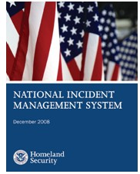
Being Prepared - NIMS
What Is the National Incident Management System?
The National Incident Management System (NIMS) provides a systematic, proactive approach to guide departments and agencies at all levels of government, nongovernmental organizations, and the private sector to work seamlessly to prevent, protect against, respond to, recover from, and mitigate the effects of incidents, regardless of cause, size, location, or complexity, in order to reduce the loss of life and property and harm to the environment. NIMS works hand in hand with the National Response Framework (NRF). NIMS provides the template for the management of incidents, while the NRF provides the structure and mechanisms for national-level policy for incident management.
www.CHCER.net

Slide 30
Being Prepared - NIMS

Slide 31
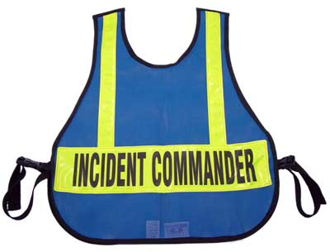
Being Prepared - ICS One
The Incident Command System (ICS) is a standardized, on-scene, all-hazards incident management approach that:
Allows for the integration of facilities, equipment, personnel, procedures and communications operating within a common organizational structure.
Enables a coordinated response among various jurisdictions and functional agencies, both public and private.
Establishes common processes for planning and managing resources.
ICS is flexible and can be used for incidents of any type, scope and complexity. ICS allows its users to adopt an integrated organizational structure to match the complexities and demands of single or multiple incidents.
ICS is used by all levels of government—federal, state, tribal and local—as well as by many nongovernmental organizations and the private sector. ICS is also applicable across disciplines. It is typically structured to facilitate activities in five major functional areas: Command, Operations, Planning, Logistics and Finance/Administration. All of the functional areas may or may not be used based on the incident needs. Intelligence/Investigations is an optional sixth functional area that is activated on a case-by-case basis.
As a system, ICS is extremely useful; not only does it provide an organizational structure for incident management but it also guides the process for planning, building and adapting that structure. Using ICS for every incident or planned event helps hone and maintain skills needed for the large-scale incidents.

Slide 32
Being Prepared - ICS Two
In February 2005, the National Integration Center (NIC) gathered together several emergency management organizations to begin collaborating on NIMS implementation. From that meeting it became clear that core competencies for ICS positions were necessary. The U.S. Fire Administration (USFA) took the lead to develop competencies for all ICS positions. In fall of 2005, the National Wildfire Coordinating Group (NWCG) added the development of wildland fire specific position competencies. USFA and NWCG prepared the ICS competencies for release. These competencies were announced online by FEMA for public comment in April of 2007. The public comment period ended on March 25, 2007.
In the spring of 2007 the NWCG brought together numerous interagency subject-matter expert groups to review the competencies and behaviors and begin revision of NWCG position task books. During these workshops additional edits to the competencies and behaviors were discovered and were proposed and accepted by the Competency Change Management Board (CCMB). A need was identified to create the CCMB. They met in August 2007 for adjudication of all comments.
Please reference the APPENDIX A for the associated documents

Slide 33
Being Prepared - ICS
Incident Management Teams
An Incident Management Team (IMT) is a comprehensive resource (a team) to either augment ongoing operations through provision of infrastructure support, or when requested, transition to an incident management function to include all components/functions of a Command and General Staff. An IMT:
Includes command and general staff members and support personnel.
Has statutory authority and/or formal response requirements and responsibilities.
Has pre-designated roles and responsibilities for members (Rostered and on-call: Identified and able to be contacted for deployment).
Is available 24/7/365.
Type 3 Incident Management Team. In August 2003, the U.S. Fire Administration convened a focus group of stakeholders and experts from across the country to best determine the means to develop Type 3 IMTs nationwide. The focus group agreed to stay with the basic National Wildfire Coordinating Group (NWCG) Incident Command System (ICS) training and typing models for the all-hazards emergency response community.

Slide 34
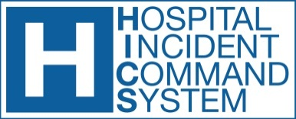
Being Prepared - HICs Overview
HICS is based upon the Hospital Emergency Incident Command System (HEICS), which was created in the late 1980s as an important foundation for the 5,815 registered hospitals in the United States in their efforts to prepare for and respond to various types of disasters. In developing the fourth edition of HEICS, the value and importance of using an incident management system to assist as well with daily operations, preplanned events, and non-emergency situations became apparent. Thus, the HICS was created as a system for use in both emergency and non-emergency situations, such as moving the facility, dispensing medications to hospital staff, or planning for a large hospital or community event.
HICS was developed by a national work group of twenty hospital subject-matter experts from across the United States. In addition to the contributions of the national work group, ex officio members were included to ensure consistency with governmental, industrial, and hospital accreditation planning efforts and requirements.

Slide 35
Being Prepared - HICs Objectives
An ICS is designed to:
Be usable for managing all routine or planned events, of any size or type, by establishing a clear chain of command
Allow personnel from different agencies or departments to be integrated into a common structure that can effectively address issues and delegate responsibilities
Provide needed logistical and administrative support to operational personnel
Ensure key functions are covered and eliminate duplication
The incident planning process takes place regardless of the incident size or complexity. This planning involves six essential steps:
Understanding the hospital’s policy and direction
Assessing the situation
Establishing incident objectives
Determining appropriate strategies to achieve the objectives
Giving tactical direction and ensuring that it is followed (e.g., correct resources assigned to complete a task and their performance monitored)
Providing necessary back-up (assigning more or fewer resources, changing tactics, et al.)

Slide 36
Being Prepared - HICs Compliance
HICs Compliance for Hospitals
The Homeland Security Presidential Directive-5 (HSPD-5), issued by President George W. Bush in February 2003, created the National Incident Management System (NIMS). Until NIMS, there had been no standard for domestic incident response that united all levels of government and all emergency response agencies. The NIMS is designed to provide a framework for interoperability and compatibility among the various members of the response community. The end result is a flexible framework that facilitates governmental and nongovernmental agencies working together at all levels during all phases of an incident, regardless of its size, complexity, or location.

Slide 37
Being Prepared – Emergency Operations Plan (EOP)
The Emergency Operations Plan (EOP) outlines the hospital’s strategy for responding to and recovering from a realized threat or hazard or other incident. The document is intended to provide overall direction and coordination of the response structure and processes to be used by the hospital. An effective EOP lays the groundwork for implementation of the Incident Command System and the needed communication and coordination between operating groups. The essence of the process includes the following steps:
Designating an Emergency Program Manager Program
Establishing the Emergency Management Committee
Developing the “all hazards ” Emergency Operations Plan
Conducting a Hazard Vulnerability Analysis
Developing incident-specific guidance (Incident Planning Guides)
Coordinating with external entities
Training key staff
Exercising the EOP and incident-specific guidance through an exercise program
Conducting program review and evaluation
Learning from the lessons that are identified (organizational learning)

Slide 38
Being Prepared – (EOP) 1 - Protection
When there is a hazard within a building such as a fire or chemical spill, occupants within the building should be evacuated or relocated to safety. Other incidents such as a bomb threat or receipt of a suspicious package may also require evacuation. If a tornado warning is broadcast, everyone should be moved to the strongest part of the building and away from exterior glass. If a transportation accident on a nearby highway results in the release of a chemical cloud, the fire department may warn to “shelter-in-place.” To protect employees from an act of violence, “lockdown” should be broadcast and everyone should hide or barricade themselves from the perpetrator.
Protective actions for life safety include:
Evacuation
Sheltering
Shelter-In-Place
Lockdown

Slide 39
Being Prepared – (EOP) 2 – Evacuation Part 1
Evacuation
Prompt evacuation of employees requires a warning system that can be heard throughout the building. Test your fire alarm system to determine if it can be heard by all employees. If there is no fire alarm system, use a public address system, air horns or other means to warn everyone to evacuate. Sound the evacuation signal during planned drills so employees are familiar with the sound.
Make sure that there are sufficient exits available at all times.
Check to see that there are at least two exits from hazardous areas on every floor of every building. Building or fire codes may require more exits for larger buildings.
Walk around the building and verify that exits are marked with exit signs and there is sufficient lighting so people can safely travel to an exit. If you find anything that blocks an exit, have it removed.
Enter every stairwell, walk down the stairs, and open the exit door to the outside. Continue walking until you reach a safe place away from the building. Consider using this safe area as an assembly area for evacuees.

Slide 40
Being Prepared – (EOP) 2 – Evacuation Part 2
Evacuation
Appoint an evacuation team leader and assign employees to direct evacuation of the building. Assign at least one person to each floor to act as a “floor warden” to direct employees to the nearest safe exit. Assign a backup in case the floor warden is not available or if the size of the floor is very large. Ask employees if they would need any special assistance evacuating or moving to shelter. Assign a “buddy” or aide to assist persons with disabilities during an emergency. Contact the fire department to develop a plan to evacuate persons with disabilities.
Have a list of employees and maintain a visitor log at the front desk, reception area or main office area. Assign someone to take the lists to the assembly area when the building is evacuated. Use the lists to account for everyone and inform the fire department whether everyone has been accounted for. When employees are evacuated from a building, OSHA regulations require an accounting to ensure that everyone has gotten out safely. A fire, chemical spill or other hazard may block an exit, so make sure the evacuation team can direct employees to an alternate safe exit.

Slide 41
Being Prepared – (EOP) 3 & 4 – Sheltering
Sheltering
If a tornado warning is broadcast, a distinct warning signal should be sounded and everyone should move to shelter in the strongest part of the building. Shelters may include basements or interior rooms with reinforced masonry construction. Evaluate potential shelters and conduct a drill to see whether shelter space can hold all employees. Since there may be little time to shelter when a tornado is approaching, early warning is important. If there is a severe thunderstorm, monitor news sources in case a tornado warning is broadcast. Consider purchasing an Emergency Alert System radio - available at many electronic stores. Tune in to weather warnings broadcast by local radio and television stations. Subscribe to free text and email warnings, which are available from multiple news and weather resources on the Internet.
Shelter-In-Place
A tanker truck crashes on a nearby highway releasing a chemical cloud. A large column of black smoke billows into the air from a fire in a nearby manufacturing plant. If, as part of this event, an explosion, or act of terrorism has occurred, public emergency officials may order people in the vicinity to “shelter-in-place.” You should develop a shelter-in-place plan. The plan should include a means to warn everyone to move away from windows and move to the core of the building. Warn anyone working outside to enter the building immediately. Move everyone to the second and higher floors in a multistory building. Avoid occupying the basement. Close exterior doors and windows and shut down the building’s air handling system. Have everyone remain sheltered until public officials broadcast that it is safe to evacuate the building.

Slide 42
Being Prepared – (EOP) 5 - Lockdown
Lockdown
An act of violence in the workplace could occur without warning. If loud “pops” are heard and gunfire is suspected, every employee should know to hide and remain silent. They should seek refuge in a room, close and lock the door, and barricade the door if it can be done quickly. They should be trained to hide under a desk, in the corner of a room and away from the door or windows. Multiple people should be trained to broadcast a lockdown warning from a safe location.
APPENDIX B contains additional resources for Guidance on Life Safety, Incident Stabilization and Property Conservation.

Slide 43
Being Prepared – HICs Process
HICS incident management team charts depict the hospital command functions that have been identified and represent how authority and responsibility are distributed within the incident management team.
The activities at the Hospital Command Center (HCC) are directed by the Incident Commander, who has overall responsibility for all activities within the HCC. The Incident Commander may appoint other Command Staff personnel to assist.
Many incidents that likely will occur involve injured or ill patients. The Operations Section will be responsible for managing the tactical objectives outlined by the Incident Commander. Branches of this section include: Department Level, Patient Care, Infrastructure, Business Continuity, Security, and HazMat.
The Planning Section will “collect, evaluate, and disseminate incident situation information and intelligence to Incident Command” and includes a Resources Unit, Situation Unit, Documentation Unit, and Demobilization Unit. Support requirements will be coordinated by the Logistics Section, and the Finance/Administration account for the costs associated with the response.
Also, several additional incident command principles and practices are covered in this section, including incident command staff identification, building incident command staff depth, job action sheets, and incident response guides.

Slide 44
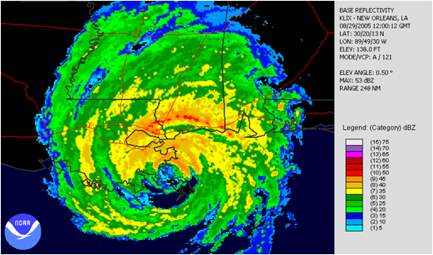
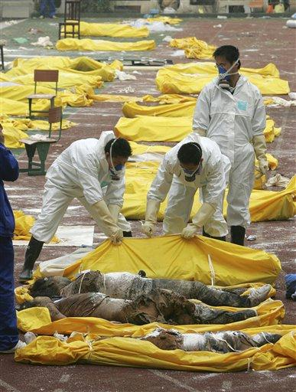
Being Prepared – HICs Event Lifecycle
The life cycle of an incident includes the following steps:
Alert and notification
Situation assessment and monitoring
EOP Implementation
Establishing the HCC
Building the ICS structure
Incident action planning
Communications and coordination
Staff health and safety
Operational considerations
Legal and ethical considerations
Demobilization
System recovery
Response evaluation and organizational learning

Slide 45
Author Comments
The author realizes that this overview has covered a very complex readiness environment for which volumes could be written. Two years following 9/11, J. Blair & Associates Inc. established a work group comprised of seasoned Healthcare professionals (150 yrs of, in the trenches, experience) to engage in a self-funded, in-depth study of the status of the healthcare industry's homeland security readiness. Early on, it was obvious to us that we needed to add antiterrorism physical security/cyber security domain experts to the group. Identification of the problem was easy, finding a solution was the challenge. Please feel free to contact me if you have questions about this article.
James D. Blair, DPA, MHA, FACHE, CMAS, FABCHS
E-Mail: drjdblair@comcast.net

Slide 46
James (Jim) D. Blair, DPA, MHA, FACHE, FABCHS, MCAS
Retired from U.S. Army in the grade of Colonel (0-6) with 28 years of active service.
Chief of Staff 7th Medical Command and USAREUR Deputy Chief Surgeon, Medical Support Services
Chief Executive Officer of Medical Facilities, including: Combat Field Hospital; Combat Evacuation Hospital; Short-Term Community Hospitals; Medical Center; Healthcare Hospital System.
Vice President Hospital Corporation of America, MIDEAST Ltd.
Chief of Education and Training, Office of the U.S. Army Surgeon General
Contract Consultant to the Joint Commission International
Consultant to Native American Tribes who had opted out of the Indian Health Service and provided for their own Tribal Healthcare Needs
Deputy for Operations, South Carolina Health and Human Services Finance Commission (annual budget-2.2 billions in 1996)
University appointments, Research Professor and numerous Adjunct Professorships
Member, The Council of Healthcare Advisors, Gerson -Lehman Group
Author of two books “UNREADY: To Err is Human “ July, 2010 Amazon and DEADLY NEGLECT: Apathy and Denial vs. Act of God” August, 2011 Amazon and a third book on Long Term Care in research phase. Also numerous Articles in Professional Journals and Newsletters on Homeland Security Healthcare Readiness

Slide 47
Authors Recommendations
This material should not be used as Legal Advice.
Differences in State, Territorial, Tribal, and Multi-Jurisdictional Laws prohibits the use of generalized legal application.
The author recommends the recently published American Health Lawyers Association: The Emergency Preparedness, Response, and recovery Checklist: Beyond the Emergency Management Plan, pp. 1- 38.
Many of the attached files come from the FEMA websites regarding ICS. To ensure the appropriate version, please refer to http://www.ready.gov/business/implementation/emergency and the three core areas below: Life Safety, Incident Stabilization, and Property Conservation tabs – each tab has additional resources for planning, training and testing in these critical areas.

Slide 48
Appendix A - ICS

Slide 49
Appendix B – EOP Life Safety, Incident Stabilization and Property Conservation 1
Alarm System
Evacuation Matrix
Evacuation Tool
HAZMAT Waste
Natural Disasters
Hurricane Events

Slide 50
Appendix B – EOP Life Safety, Incident Stabilization and Property Conservation 2
Thunderstorm Events
Performance Objectives
Resource Ready 1
Resource Ready 2
Resource Ready 3
Resource Ready 4
Training Ready 1
Testing and Exercise

Slide 51
Center for HealthCare Emergency Readiness 2200 21st Avenue South, Suite 221 Nashville, TN 37212 Email: info@CHCER.org Phone: (615)385-3200 Fax: (615)386-9094 WWW.CHCER.NET or WWW.CHCER.ORG

